Slide 1
Can a Robot Learn to Avoid
Obstacles from Relative
Observations Alone?
Robot Learning Group Selection · Phase A
Diagnosing the behavior cloning baseline, and a policy built on contact mapping, replanning, and symmetric BC
Yujia · November 2026
Notes:
Hello, I am Yujia. My topic today is whether a robot can learn to avoid obstacles from relative observations alone. I will cover the task setup, a diagnosis of the baseline and the demonstration data, the method and a live demonstration, the evaluation criteria and results, and related work. I will close with the open problems and next steps.

Slide 2
01 · Opening
Success rate (public set)
Mean steps
Success with 8–10 obstacles
1.000
6.1
0.999
Baseline 0.830
Baseline 17.9
Baseline 0.532
1.000 on all 3 seeds
Oracle (true map): 5.7 steps
Stress test: 0.692 → 0.998
The gain comes from memory and structure: these 4,000 single-step demonstrations can teach only “move toward the goal.”
Phase A · Obstacle Avoidance from Relative Observations
2 / 26
Notes:
On the official public set, the success rate rises from 0.830 for the baseline to 1.000, and the mean number of steps falls from 17.9 to 6.1. The oracle with access to the true map needs 5.7 steps. In scenes with 8 to 10 obstacles, the baseline drops to 0.532, whereas my method achieves 0.999. The improvement comes from memory and planning structure. The data-budget experiment later in the talk shows that these single-step demonstrations can teach only one thing: “move toward the goal.”

Slide 3
Task Setup: Only a Vector to the Goal
01 · Opening
Element | Setting
Observation | obs = [Δx, Δy] = goal − robot; no absolute coordinates, no map
Action | 2D direction, normalized by the environment to a fixed step of 0.08
Collision | If the next step would enter an obstacle, the robot stays put and a collision is counted
Demonstrations | 4,000 (obs, action) pairs, each from a new random map: only the A* direction at the start, plus noise
Evaluation | 300 scenarios, 80-step limit; success = within 0.05 of the goal and not inside an obstacle
Hidden tests | New layouts, more obstacles, noise, shorter step limits → no scenario may be hard-coded
Phase A · Obstacle Avoidance from Relative Observations
3 / 26
Notes:
The observation is the goal position minus the robot's position; there are no absolute coordinates and no map. The action is a 2D direction, which the environment normalizes to a fixed step size of 0.08. If the next step would land inside an obstacle, the robot stays in place, and a collision is recorded. There are 4,000 demonstrations, each drawn from a new random map. Each one records only the A* direction at the start position, with added noise. Evaluation uses 300 scenarios with an 80-step limit, and an episode succeeds when the robot comes within 0.05 of the goal. The hidden tests will change the layouts, add obstacles, add noise, and shorten the step limit. The experiments that follow cover each of these changes.

Slide 4

Why the Baseline Fails: Permanent Deadlock
02 · Diagnosis
1
2
3
4
Move toward the goal
Blocked, stays in place
Observation unchanged
Same action again
obs carries no new information
Memoryless → blocked again
Linear BC ≈ goal direction
The step hits an obstacle
Back to step 2, repeated until all 80 steps are used
51 / 51
77 / 80
0.830
Failed public episodes that end stuck in place
Mean blocked steps per failed episode
Baseline success rate on the public set
Phase A · Obstacle Avoidance from Relative Observations
4 / 26
Notes:
The baseline fails in 51 episodes on the public set, and every one of them is a deadlock. Linear BC approximately moves toward the goal. When an obstacle lies ahead, the step is blocked, so neither the position nor the observation changes. The memoryless policy therefore outputs the same action and is blocked again, and this repeats until all 80 steps are used. On average, 77 steps of each failed episode are blocked. The root cause is partial observability combined with the absence of memory: a single observation cannot distinguish “the way ahead is clear” from “there is a wall ahead.”

Slide 5
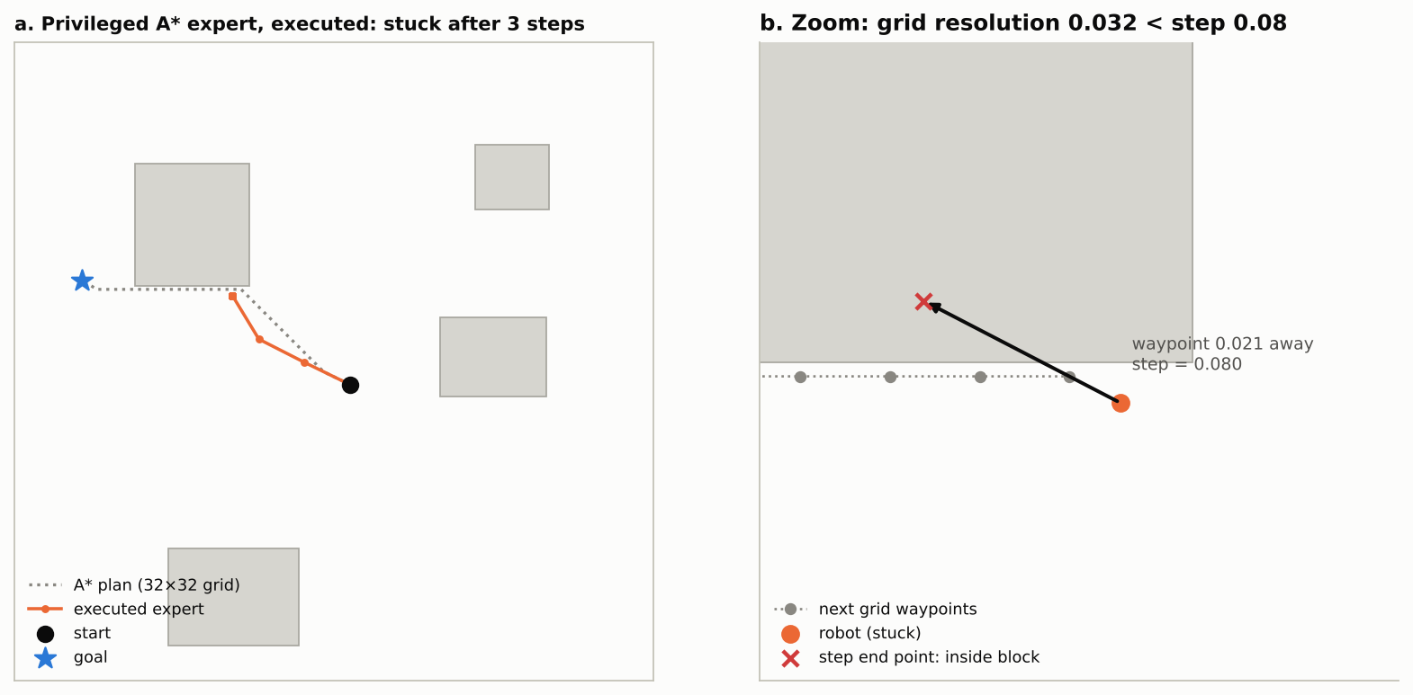
Control: Even the A* Expert Deadlocks
02 · Diagnosis
0.837
Success of the executed expert, the same as moving straight to the goal
49 / 49
Failed episodes that end stuck in place
Grid spacing 0.032 < step 0.08: aiming at a waypoint 0.02 away, one step lands inside the obstacle
Design principle: evaluate an action by its actual landing point, not by the next grid waypoint.
Phase A · Obstacle Avoidance from Relative Observations
5 / 26
Notes:
When the A* expert is executed directly with access to the true map, its success rate is 0.837. This is the same as moving in a straight line toward the goal, and all 49 failed episodes end stuck in place. The A* grid spacing is about 0.032, whereas the robot moves 0.08 per step. The expert points to the next grid waypoint, which is only 0.02 away. Moving the full 0.08 in that direction places the landing point inside the obstacle. Once the robot is blocked, neither its position nor the expert's output changes. This yields a design principle: an action should be evaluated by its actual landing point.

Slide 6
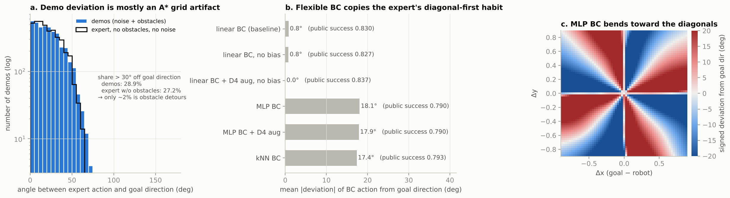
Demo Deviation Is Mostly a Grid Artifact
02 · Diagnosis
27.2%
45% vs. 18%
0.790 < 0.830
Expert actions > 30° off the goal direction with no obstacles and no noise (28.9% in the demos)
Share of first steps near a diagonal: expert vs. true goal directions
MLP learns the diagonal-first habit and does worse than linear BC in closed loop
Phase A · Obstacle Avoidance from Relative Observations
6 / 26
Notes:
Of the demonstrated actions, 28.9% deviate from the goal direction by more than 30°. In a control setting with no obstacles and no noise, 27.2% of the expert's actions already exceed 30°, so obstacle detours account for only about 2% of the deviation. The deviation comes from A*'s use of a Manhattan heuristic on an 8-connected grid, which favors diagonal moves first. In this control setting, 45% of the expert's first steps lie near a diagonal direction, compared with only 18% of the true goal directions. MLP and kNN learn this habit. In closed loop, they follow zigzag paths and collide more often, reaching success rates of 0.790 and 0.793, respectively, below the 0.830 of linear BC.

Slide 7
The Observation Sequence Carries Two Signals
Key Insight
①
②
obs barely changes after a step
The goal is fixed within an episode
= a collision. A normal step changes the observation by 0.08, so this is a free contact sensor.
The robot’s position in the goal frame is −obs. Every step is a fresh measurement, with no drift.
So a robot without a map can still build one by bumping into obstacles.
Phase A · Obstacle Avoidance from Relative Observations
7 / 26
Notes:
The observation contains no map, but the observation sequence carries two signals. First, a normal step changes the observation by 0.08; if it barely changes, the robot has hit an obstacle, so the observation stream effectively provides a contact sensor. Second, the goal is fixed within an episode, so the robot's position in the goal frame equals −obs. Each step yields a fresh measurement, so no drift accumulates. With these two signals, the robot can record collision locations and build a map at run time.

Slide 8
Three Memory-Based Policies
03 · Method
Version | After a collision | Memory needed | Public | 8–10 obstacles
Baseline (linear BC) | Nothing (repeats the same action) | None | 0.830 | 0.532
3a Random escape | Moves in a random direction for 3 steps | Step counter | 1.000 | 0.943
3b Bug / wall-follow | Follows the wall on one side; leaves once closer to the goal than the hit point | Mode + hit-point distance | 0.997 | 0.983
3c Map + plan | Records contact points on a map and replans on it | Goal-frame grid map | 1.000 | 0.999
Breaking the deadlock solves the public set; with more obstacles, richer memory wins.
Phase A · Obstacle Avoidance from Relative Observations
8 / 26
Notes:
I built three versions with increasingly rich memory. In 3a, the robot moves in a random direction for three steps after a collision, which requires only a counter. It already reaches 1.000 on the public set, which shows that deadlock is the bottleneck in simple scenes. In 3b, which follows Bug2, the robot follows the wall after a collision and leaves it once it is closer to the goal than the collision point. In 3c, the robot records contact points on a map and replans; this is the submitted version. The gap widens as obstacles increase: with 8 to 10 obstacles, the three versions reach 0.943, 0.983, and 0.999, respectively.

Slide 9
StudentPolicy: How Each Step Is Decided
03 · Method
③
①
②
Update contact map
④
Observe
Detect
Line free?
obs = [Δx, Δy]
New episode? Was the last step blocked?
Goal-frame grid; mark the intended point, radius 0.06
Does the path to the goal hit a marked cell?
Yes → BC prior
No → Value-field planning
Follow the learned direction (D4-symmetric linear BC, i.e., “move toward the goal”)
Dijkstra from the goal gives a cost-to-go field V; among 48 directions, pick the one whose actual 0.08 landing point has the lowest V and is not marked
Unexplored cells are assumed free (free-space assumption); V is recomputed only after a new collision.
Phase A · Obstacle Avoidance from Relative Observations
9 / 26
Notes:
Each step has four stages. First, the policy reads the observation. Second, it determines whether a new episode has started and whether the previous step was blocked. Because the evaluation function never calls reset, episode boundaries must be inferred from the observations. Third, after a collision, it marks the point the robot attempted to reach on a goal-centered grid map, with an inflation radius of 0.06. Unexplored regions are treated as traversable, following the free-space assumption of D* Lite. Fourth, if the straight line to the goal is free on the map, the policy uses the BC prior. Otherwise, it runs Dijkstra's algorithm from the goal to obtain a cost-to-go field V. Among 48 directions, it then selects the one whose actual 0.08 landing point has the lowest cost, provided that neither the landing point nor the midpoint is marked.

Slide 10
Core Code: Collisions and Episode Boundaries
03 · Method
Observation only
# ContactTracker.observe(obs)
No map, goal coordinates, or scenario information is read
moved = norm(obs - prev_obs)
if norm(prev_obs) < 0.05 or moved > 2.0 * step:
new_episode = True # evaluate() never calls reset()
Two thresholds
elif moved < 0.5 * step:
collided = True # did not move = blocked
Collision: moved < 0.5 × step
New episode: jump > 2 × step
hit = -prev_obs + step * prev_act
# StudentPolicy.act(obs)
p = -obs # position in the goal frame
Cost
if collided: mark_disc(hit, r=0.06)
About 20 ms per replanning, only after a new collision; about 3 s for 300 public episodes
if no_hits or line_free(p, goal):
a = bc_prior(obs) # learned direction
else:
a = argmin over 48 dirs of V(p + 0.08 * dir)
Phase A · Obstacle Avoidance from Relative Observations
10 / 26
Notes:
(Switch to the editor and walk through src/policy.py.) ContactTracker makes two decisions based on the change in observation. If the previous observation was already within the success radius, or if the observation jumps by more than two step lengths, a new episode has begun. If the robot moves less than half a step, it has been blocked, and the contact point is −prev_obs + 0.08·prev_act. The policy uses only the observation and never reads the map or any scenario information. Each replanning takes about 20 ms, and the 300 public episodes take about 3 seconds in total.

Slide 11
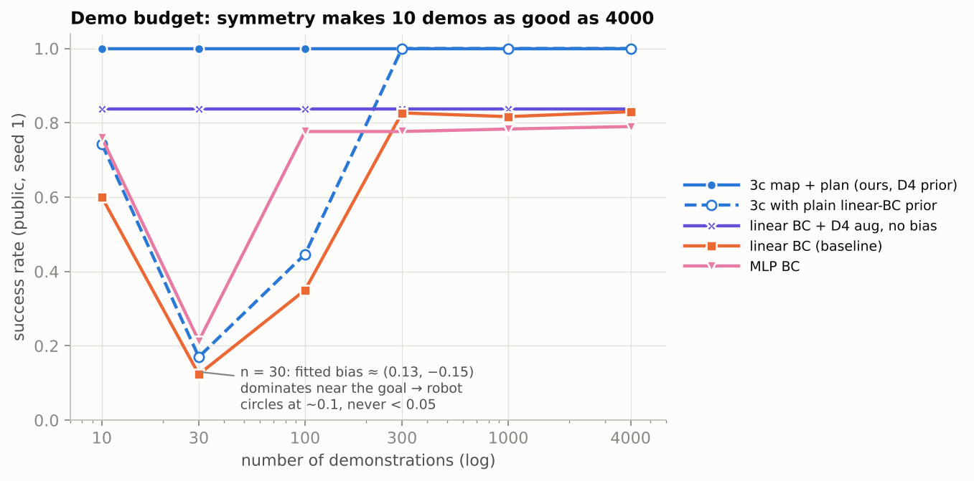
Symmetric BC: 10 Demonstrations Match 4,000
03 · Method
Observation
Scenarios are invariant under the 8 symmetries of the square (D4)
Start and goal are uniform; obstacles are axis-aligned rectangles with i.i.d. width and height
Method
Each demonstration (obs, a) → 8 demonstrations (g·obs, g·a)
A bias-free linear BC fit gives W = 1.549 · I, exactly “move toward the goal”
Contrast
Plain linear BC with n = 30
Bias ≈ (0.13, −0.15) dominates near the goal → the robot circles it; success 0.123
Phase A · Obstacle Avoidance from Relative Observations
11 / 26
Notes:
The start and goal positions are uniformly distributed, and the obstacles are axis-aligned rectangles whose widths and heights are independent and identically distributed. The scenario distribution is therefore invariant under the eight rotations and reflections of the square, which form the D4 group. Each demonstration (obs, a) can thus be expanded into eight demonstrations (g·obs, g·a). Fitting a bias-free linear BC model to the augmented data gives W = 1.549·I, which corresponds exactly to “move toward the goal.” The figure on the right shows the data-budget experiment. With 30 demonstrations, ordinary linear BC learns a bias of about (0.13, −0.15). Near the goal, this bias dominates the action, the robot circles the goal, and the success rate is only 0.123. With symmetry, 10 demonstrations perform as well as 4,000.

Slide 12
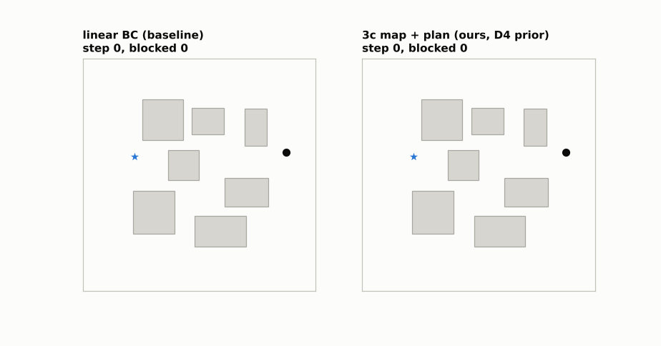
Demo: Baseline vs. StudentPolicy
03 · Method
Phase A · Obstacle Avoidance from Relative Observations
12 / 26
Notes:
On the left is the baseline: it hits an obstacle on the first step and then stays in place. On the right is StudentPolicy: after one collision, it marks the contact point with a red circle, moves around the edge of the obstacle, and reaches the goal in about 10 steps. (Switch to Colab and run Cells 4 and 10 to show the results on the public set and the stress test.)

Slide 13
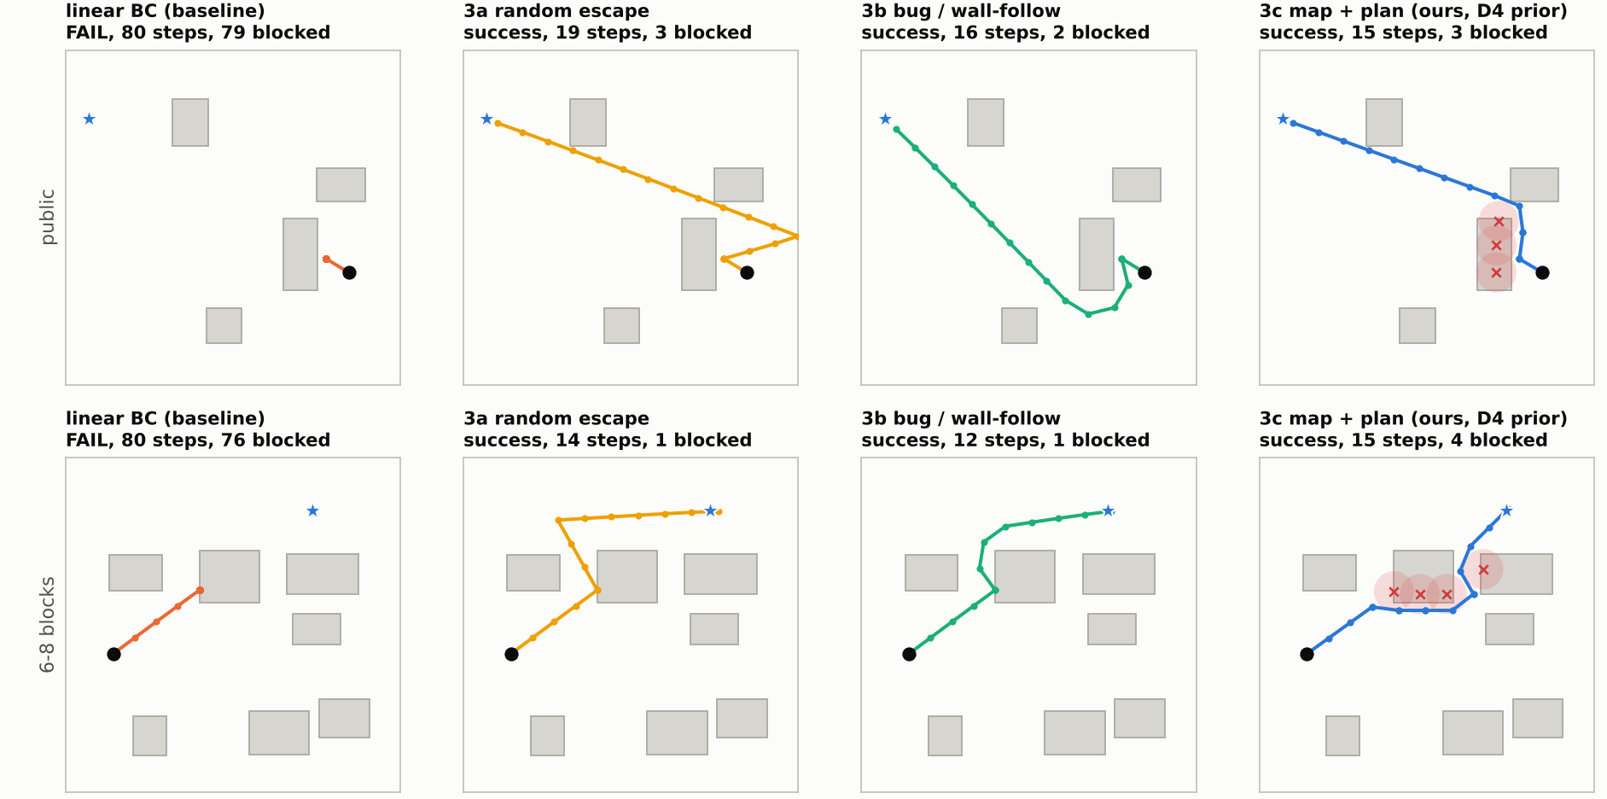
Four Policies on the Same Scenarios
03 · Method
Phase A · Obstacle Avoidance from Relative Observations
13 / 26
Notes:
The top row comes from the public set, and the bottom row has 6 to 8 obstacles. The baseline deadlocks in both. 3a escapes, but along a random route. 3b detours along the walls, which produces longer paths. 3c leaves a contact point at each collision; as the map fills in, its route comes closest to the shortest path.

Slide 14
Tuning: The Contact Inflation Radius
03 · Method
Validation seed 100 (public set not used). Left three columns: 5–8 obstacles; right two: public difficulty + observation noise 0.02
Radius | Success | Steps | Blocked steps | Steps (noise) | Blocked (noise)
0.02 | 0.997 | 8.19 | 2.13 | 7.48 | 1.35
0.03 | 1.000 | 7.64 | 1.51 | 7.36 | 1.14
0.04 | 1.000 | 7.50 | 1.33 | 7.10 | 0.86
0.06 | 1.000 | 7.49 | 1.08 | 7.22 | 0.67
0.08 | 1.000 | 8.19 | 1.15 | 7.08 | 0.53
Too small (0.02): repeated hits on the same wall
Too large (0.08): long detours in dense scenes
Chosen: 0.06: best in dense scenes; 0.08 is slightly better with noise
Phase A · Obstacle Avoidance from Relative Observations
14 / 26
Notes:
Tuning is performed on validation seed 100, without using the public set. With a radius of 0.02, the robot repeatedly collides along the same wall and is blocked for 2.13 steps per episode. With a radius of 0.08, narrow gaps between dense obstacles are sealed off, and the mean number of steps rises to 8.19. With observation noise, however, a radius of 0.08 gives the fewest blocked steps (0.53), so there is a trade-off. I chose 0.06 because it yields the fewest steps and the fewest blocked steps in the harder dense-obstacle setting. (Switch to Colab, run Cell 8, and change the radius to compare the results live.)

Slide 15
How I Define “Good”
04 · Results
Metric | Why it matters | Note
Success rate | The task itself | Primary metric
Mean steps | Efficiency; hidden tests may shorten the step limit | Decides whether the robot arrives in time
Blocked steps / episode | The actual cost of collisions | Metric I added
Collision-episode rate | Share of episodes with at least one collision | Has a lower bound with contact sensing only
Final distance | How far a failed episode ends from the goal | Partial progress
Protocol: 3 seeds × 300 episodes per setting, mean ± std; hyperparameters chosen only on validation seed 100; the oracle (a planner with the true map) is an upper-bound reference, not a submission.
Phase A · Obstacle Avoidance from Relative Observations
15 / 26
Notes:
Success rate is the primary metric. The mean number of steps measures efficiency; because the hidden tests may shorten the step limit, this metric determines whether the robot arrives in time. The number of blocked steps per episode, a metric I added, measures the actual cost of collisions. I also report the collision-episode rate. For a robot with contact sensing only, however, this metric has a lower bound: in episodes where the straight path is blocked, the first collision is unavoidable. Each setting is run with 3 seeds of 300 episodes each. Hyperparameters are selected only on the validation seed, and the oracle serves only as an upper-bound reference.

Slide 16
Results on the Public Set (Seed 1)
04 · Results
Policy | Success | Mean steps | Blocked / ep. | Coll.-ep. rate
Linear BC (baseline) | 0.830 | 17.9 | 13.14 | 0.170
Linear BC + D4 augmentation | 0.837 | 17.4 | 12.62 | 0.163
MLP BC | 0.790 | 21.2 | 16.24 | 0.210
kNN BC | 0.793 | 20.9 | 15.96 | 0.207
3a Random escape | 1.000 | 7.8 | 0.46 | 0.170
3b Bug / wall-follow | 0.997 | 6.7 | 0.32 | 0.170
3c StudentPolicy (submitted) | 1.000 | 6.1 | 0.34 | 0.163
Oracle (true map, reference) | 1.000 | 5.7 | – | 0.000
Mean over seeds 1 / 2 / 3: baseline 0.808 ± 0.025; 3c 1.000 ± 0.000 (6.3 steps)
Phase A · Obstacle Avoidance from Relative Observations
16 / 26
Notes:
These settings match the notebook. All pure BC variants lie between 0.79 and 0.84, so model capacity is not the bottleneck. With memory, the success rate reaches about 1.000, and 3c's 6.1 steps come closest to the oracle's 5.7. The baseline and all three memory-based methods have collision-episode rates between 0.16 and 0.17; this is the lower bound described on the previous slide.

Slide 17
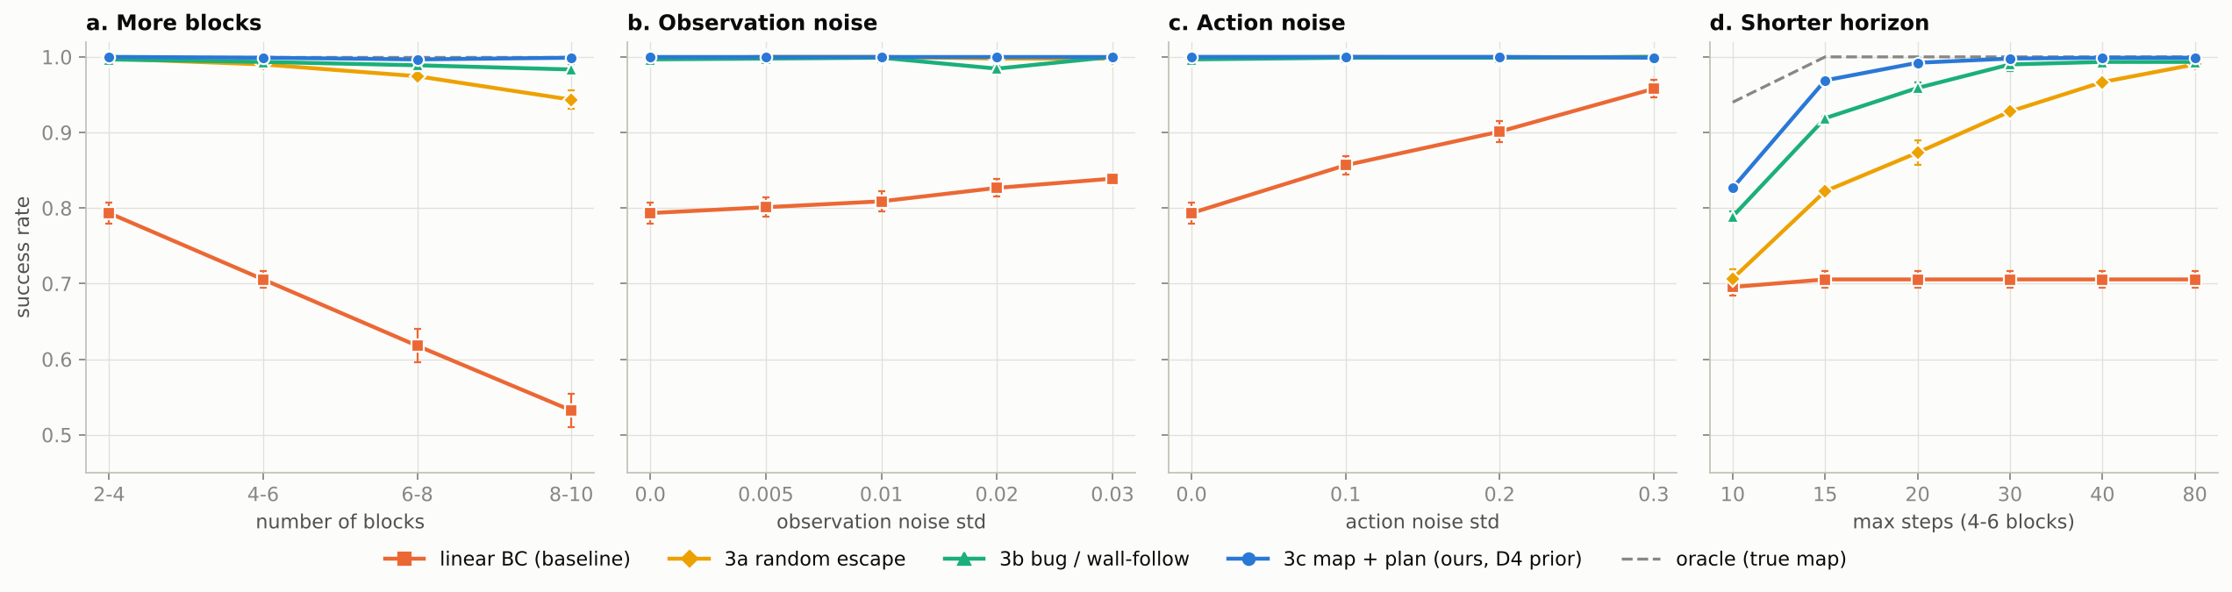
Robustness Under Harder Conditions
04 · Results
0.532 → 0.999
0.793 → 0.958
0.827 vs. 0.940
8–10 obstacles: baseline vs. 3c
Action noise 0 → 0.3: noise helps the baseline break deadlocks
10-step limit: 3c vs. oracle, the remaining gap
Phase A · Obstacle Avoidance from Relative Observations
17 / 26
Notes:
As the number of obstacles grows, the baseline degrades quickly, falling to 0.532 with 8 to 10 obstacles, whereas 3c holds at 0.999. Noise actually improves the baseline. As action noise increases from 0 to 0.3, its success rate rises from 0.793 to 0.958, because random perturbations break the deadlock by the same mechanism as in 3a. The gap becomes pronounced only when the step limit is shortened: with a 10-step limit, 3c reaches 0.827 and the oracle 0.940.

Slide 18
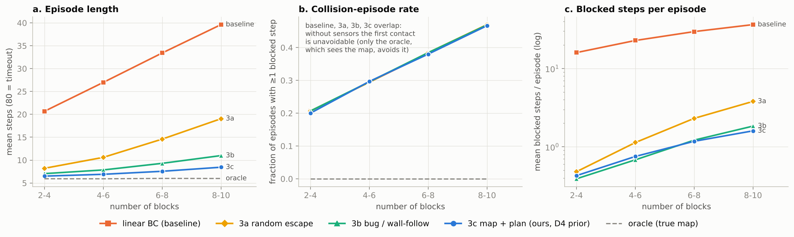
Stress Test: 6–8 Obstacles, Noise, 40 Steps
04 · Results
Baseline
3a Random escape
3b Wall-follow
3c (submitted)
Oracle (reference)
0.692
0.911
0.983
0.998
1.000
16.4 steps
12.2 steps
9.0 steps
7.9 steps
6.1 steps
Phase A · Obstacle Avoidance from Relative Observations
18 / 26
Notes:
When 6 to 8 obstacles, observation noise of 0.01, action noise of 0.1, and a 40-step limit are combined, the baseline reaches 0.692, 3a 0.911, 3b 0.983, and 3c 0.998, with a mean of 7.9 steps. In the three plots below, the four collision-episode-rate curves coincide, which confirms that the first collision is unavoidable. In blocked steps per episode, the memory-based methods are an order of magnitude below the baseline.

Slide 19
Strict Collision Checking: Ranking Unchanged
04 · Results
Policy | Public | 6–8 obstacles | Stress test
Baseline | 0.830 → 0.787 | 0.618 → 0.567 | 0.692 → 0.611
3a Random escape | 1.000 → 0.997 | 0.974 → 0.929 | 0.911 → 0.844
3b Wall-follow | 0.997 → 0.997 | 0.989 → 0.970 | 0.983 → 0.946
3c (submitted) | 1.000 → 1.000 | 0.997 → 0.991 | 0.998 → 0.988
Oracle (reference) | 1.000 → 1.000 | 1.000 → 0.999 | 1.000 → 1.000
The simulator checks only landing points
env.step tests only the landing point. With sides ≥ 0.09 > step 0.08, a step can cut across an obstacle corner.
39 / 300
Successful 3c episodes on the public set that cut a corner; oracle: 42 / 300
Strict: a step is blocked if any point on its path is inside an obstacle; policy code unchanged. Success shown as original → strict; public = seed 1; 6–8 obstacles = seeds 11–13; stress = seeds 21–23.
The baseline drops the most (it falls back into deadlock); among memory-based methods, 3c drops the least.
Phase A · Obstacle Avoidance from Relative Observations
19 / 26
Notes:
The simulator has a bug: env.step checks only the landing point, not the path. A single step can therefore cut across the corner of an obstacle. On the public set, 39 of the 300 successful 3c episodes contain such a step, as do 42 oracle episodes, so success under the original rule does not mean that the path is physically collision-free. I implemented a strict environment in which a step is blocked if any point along its path enters an obstacle, and I left the policy code unchanged. 3c still achieves 1.000 on the public set, 0.991 with 6 to 8 obstacles, and 0.988 on the stress test. The baseline drops the most, to 0.611 on the stress test, because paths that previously slipped across obstacle corners are now blocked and fall back into deadlock. The ranking of the methods is unchanged. (Switch to Colab and run Cell 11.)

Slide 20
Related Work (1/2): Imitation and Navigation
05 · Related Work
DAgger
Bug2
D* Lite
Ross, Gordon & Bagnell · AISTATS 2011
Lumelsky & Stepanov · Algorithmica 1987
Koenig & Likhachev · AAAI 2002
What they did
What they did
BC errors compound; DAgger runs the learned policy, has the expert label visited states, and retrains on all the data.
What they did
Navigation in unknown terrain: assumes unseen cells are free and replans incrementally from the goal as obstacles appear.
A point robot with contact sensing only: follow the start–goal line, follow the boundary after a hit, leave when back on the line and closer; provably complete.
What I took
What I took
Demos here come only from start states, so the shift is worse; my next experiment uses it.
3c’s free-space assumption and goal-rooted cost field, recomputed after each collision.
What I took
Exactly this task’s setting; 3b follows it, leaving once closer than the hit point.
Phase A · Obstacle Avoidance from Relative Observations
20 / 26
Notes:
DAgger shows that errors in BC compound over time. It addresses this problem by executing the learned policy, querying the expert for labels on the visited states, and retraining on the aggregated data. In this task, demonstrations are collected only at start positions, so the distribution shift is more severe; my next experiment will adopt this training scheme. Bug2 studies a point robot with contact sensing only and no map. The robot moves along the line from the start to the goal, follows the obstacle boundary after a collision, and leaves the boundary when it returns to the line at a point closer to the goal. The algorithm is proven to reach the goal whenever the goal is reachable. This is exactly the setting of this task, and 3b is based on it. D* Lite assumes that unobserved regions are traversable and, upon discovering obstacles, replans incrementally from the goal. 3c adopts the same assumption and cost-field structure.

Slide 21
Related Work (2/2): Belief, Symmetry, Multimodality
05 · Related Work
POMDP
SO(2)-Equivariant RL
MDN / Diffusion Policy
Kaelbling, Littman & Cassandra · AI Journal 1998
Wang, Walters & Platt · ICLR 2022
Bishop 1994 · Chi et al., RSS 2023
What they did
What they did
What they did
Builds rotational symmetry into policies and value functions with equivariant networks, improving sample efficiency in robot learning.
Model multimodal action distributions with mixtures or diffusion instead of only the conditional mean.
Under partial observability, the optimal policy depends on the belief over the hidden state, not on a single observation.
What I took
What I took
What I took
The same idea for the discrete D4 group, as data augmentation: 10 demos = 4,000.
MSE-trained BC learns the mean: averaging “go left” and “go right” drives straight into the obstacle.
A single obs is not enough; the contact map is a simplified belief, which requires memory.
Phase A · Obstacle Avoidance from Relative Observations
21 / 26
Notes:
The POMDP framework shows that, under partial observability, the optimal policy depends on the belief, that is, the estimate of the hidden state. The contact map is a simplified belief. Wang, Walters, and Platt build rotational symmetry into robot policies with equivariant networks, which improves sample efficiency. I apply the same idea to the discrete D4 symmetry through data augmentation. MDN and Diffusion Policy model multimodal action distributions. BC trained with MSE learns the conditional mean, and averaging “go around on the left” with “go around on the right” yields “drive straight into the obstacle.” This explains why BC cannot learn to avoid obstacles in this task.

Slide 22
Unsatisfactory Results
06 · Reflection
Learning contributes little
Still behind the oracle at short horizons
MLP 0.790 · kNN 0.793 < linear 0.830
Replacing 3c’s prior with the plain goal direction gives the same result.
10-step limit: 0.827 vs. 0.940
The collision-episode rate has a floor and cannot go lower.
Why
Single-step, map-free demos from independent random scenes → E[a | obs] can only be “move toward the goal” plus grid artifacts. Obstacle information is not in (obs, a).
Why
With contact sensing only, each discovered obstacle costs a step; the free-space assumption drives the robot into undiscovered obstacles.
Phase A · Obstacle Avoidance from Relative Observations
22 / 26
Notes:
First, the learning component contributes little to the final performance. MLP and kNN both perform worse than linear BC, and on the validation set, replacing 3c's prior with the plain goal direction gives the same results. The cause lies in the data. The demonstrations are single-step, contain no map, and come from mutually independent random scenes. The conditional distribution of actions given an observation therefore contains only “move toward the goal” plus grid artifacts, and the information needed to avoid obstacles is absent from (obs, a). Second, with a very short step limit, 3c still trails the oracle: 0.827 versus 0.940 with 10 steps. With contact sensing only, each discovered obstacle costs a step, and the free-space assumption leads the robot straight toward obstacles it has not yet discovered.

Slide 23
If I Could Run One More Experiment
06 · Reflection
Experiment: a BC policy with memory
Question
Can wall following and remembering contact locations be learned end to end, and with how much data?
Use 3c as a teacher to generate multi-step trajectories
Input = last k observations + collision flags
Train a GRU or small Transformer BC
Correct compounding errors with DAgger
What each outcome means
Learnable → the bottleneck is the data format (single-step, no history)
Not learnable → such structure must be designed explicitly
Phase A · Obstacle Avoidance from Relative Observations
23 / 26
Notes:
I would use 3c as a teacher to generate multi-step trajectories and change the input to the most recent k observations plus collision flags. I would then train a GRU or a small Transformer and use DAgger to correct compounding errors. The question is whether behaviors such as wall following and remembering collision locations can be learned end to end, and how much data that requires. If they can, the bottleneck lies in the data format, namely single-step demonstrations without history. If they cannot, such structure must be designed explicitly.

Slide 24
Limitations and Suspected Bugs
06 · Reflection
The simulator checks only landing points
The provided expert
A step can cut across an obstacle corner; under strict checks, 3c still scores 1.000 on the public set and the ranking holds.
Grid 0.032 < step 0.08, so it deadlocks when executed; its Manhattan heuristic is not admissible on an 8-connected grid, hence diagonal-first moves.
Heuristic episode detection
Hard-coded constants and thresholds
If the previous episode times out and the new start is within 0.16 of the last observation, the old map is carried over.
Step 0.08 and success radius 0.05 are hard-coded; the collision threshold is validated for observation noise ≤ 0.03; about 20 ms per replanning.
Phase A · Obstacle Avoidance from Relative Observations
24 / 26
Notes:
The provided expert has two problems. Its grid is finer than the step size, so it deadlocks when executed, and its Manhattan heuristic is not admissible on an 8-connected grid, which causes it to move diagonally first. My policy has three limitations. First, episode boundaries are detected heuristically: if the previous episode times out and the new start observation differs from the last observation by less than 0.16, the old map is carried over. Second, the step size and success radius are hard-coded. Third, the collision threshold has been validated only for observation noise of up to 0.03.

Slide 25
Three Takeaways
Summary
1
2
3
Root cause of failure
Observation stream = contact sensor + odometry
Limits of learning
Deadlock caused by partial observability and the absence of memory; the executed expert fails the same way.
Symmetry makes 10 demos enough, but obstacle information is absent from single-step demos.
Mapping + replanning: public success 1.000 in 6.1 steps on average; still 1.000 under strict collision checks.
Code, all experimental results, and plotting scripts: https://github.com/Candice-Zhang427/Robotics-Lab-Test.git Thank you!
Phase A · Obstacle Avoidance from Relative Observations
25 / 26
Notes:
I will close with three conclusions. First, the baseline fails through deadlock caused by partial observability combined with the absence of memory, and the executed expert fails in the same way. Second, the observation stream provides both contact sensing and odometry. Using them for mapping and replanning yields a success rate of 1.000 on the public set, with 6.1 steps on average, and the success rate remains 1.000 under strict collision checking. Third, symmetry reduces the number of demonstrations that BC needs to 10, but the information needed to avoid obstacles is absent from single-step demonstrations; this is the direction I will pursue next. All code and experimental results are available in the GitHub repository and are fully reproducible. Thank you.

Slide 26
Overall Approach
Summary
Diagnosis
Idea
All 51 baseline failures are deadlocks; the executed A* expert deadlocks too (grid 0.032 < step 0.08). Demo deviation is mostly a grid artifact; detours ≈ 2%.
An unchanged observation signals a collision; with the goal fixed, the goal-frame position is −obs. Together they enable online contact mapping.
Method
Results
D4-augmented linear BC prior + contact map (inflation 0.06) + Dijkstra cost-to-go field; pick the direction whose actual 0.08 landing point is cheapest.
Public set: 0.830 → 1.000 success, 17.9 → 6.1 steps (oracle 5.7). 8–10 obstacles: 0.532 → 0.999. Stress test: 0.692 → 0.998.
Evaluation rule
Scope
The simulator checks only landing points. Under strict segment checks, 3c scores 1.000 / 0.991 / 0.988 vs. baseline 0.787 / 0.567 / 0.611; ranking unchanged.
Gains come from memory and planning; single-step demos teach only “move toward the goal.” At 10 steps: 3c 0.827 vs. oracle 0.940.
Phase A · Obstacle Avoidance from Relative Observations
26 / 26
Notes:
Task: A point robot observes only the position of the goal relative to itself, [Δx, Δy], and cannot see obstacles. The objective is to learn a navigation policy from 4,000 single-step demonstrations. Diagnosis. Every baseline failure is a deadlock. After the robot hits an obstacle, its position does not change, so its observation does not change either, and the memoryless policy repeats the same action. When executed, the provided A* expert deadlocks in the same way, because its grid spacing (0.032) is finer than the step size (0.08). Most of the deviation in the demonstrated actions comes from A*'s tendency to move diagonally first; obstacle detours account for only about 2%. Idea. The observation sequence carries two kinds of information. If the observation barely changes after a step, the robot has collided. Because the goal is fixed within an episode, the robot's position in the goal frame equals −obs. Together, these two signals allow the robot to build a contact map as it moves. Method. StudentPolicy consists of three components: a learned direction prior, a contact map, and value-field replanning. The prior is a linear BC model trained on D4-augmented data. Each contact point is marked on a goal-frame grid with an inflation radius of 0.06. When a detour is needed, Dijkstra's algorithm is run from the goal to obtain a cost-to-go field, and the policy selects, among 48 directions, the action whose actual 0.08 landing point has the lowest cost. Results. On the public set, the success rate rises from 0.830 to 1.000, and the mean number of steps falls from 17.9 to 6.1, compared with 5.7 for the oracle that has access to the true map. With 8–10 obstacles, the success rate rises from 0.532 to 0.999; on the combined stress test, it rises from 0.692 to 0.998. Evaluation rule. The simulator checks only whether the landing point of each step lies inside an obstacle, not the path in between, so a single step can cut across the corner of an obstacle. On the public set, 39 of the 300 successful 3c episodes contain such a step, as do 42 oracle episodes. In a strict environment that checks every segment, with the policy code unchanged, 3c still achieves 1.000 on the public set, 0.991 with 6–8 obstacles, and 0.988 on the stress test. Under the same conditions, the baseline drops to 0.787, 0.567, and 0.611, respectively. The ranking of the methods is unchanged. Scope. The improvement comes from memory and planning structure. Single-step demonstrations without maps can teach only “move toward the goal.” With a 10-step limit, 3c reaches 0.827, compared with 0.940 for the oracle; this gap is the cost of exploring by contact alone.

